Slide 1

Amazon Sales Data Analysis
By :- Bhawesh Sinha
(Data Scientist)

Slide 2
Introduction
Welcome to our Amazon sales data analysis presentation. In this session, we'll explore the intricate web of insights hidden within the vast expanse of Amazon sales data. Through meticulous examination and advanced analytics, we aim to uncover trends, customer behaviors, and product performance metrics. By harnessing the power of data science, we'll provide actionable recommendations to optimize marketing efforts, enhance inventory management, and ultimately drive revenue growth. Join us on this journey as we unlock the potential of your Amazon sales data to propel your business towards greater success in the competitive online marketplace.

Slide 3
Details of Data
1. Region = Area of the Country where service was given.
2. Country = Country in which Area located.
3. Item Type = Type of product among 12 categories.
4. Sales Channel = Mode of sales (Online/Offline)
5. Order priority = Priority on the basis of self life and other factor (C = Custom, L = Low, M = Medium, H = High)
6. Order date = The date on which the order was placed by the customer.
7. Order ID = Unique Identification for the specific order.
8. Ship Date = Date of Dispatchment.
9. Unit sold = Total unit sold.
10. Unit Price = Price(MRP) of a single product.
11. Unit Cost = Price at which the product was sold.
12. Total Revenue = Total money gained after the sale.
13. Total Cost = Actual cost calculated.
14. Total Profit = Net Profit after sale (Difference of Total Revenue and Total Cost).

Slide 4
Main KPIs
Region
Item Type
Order Priority
Year of Order
Month of Year
Total Revenue
Total Profit

Slide 5
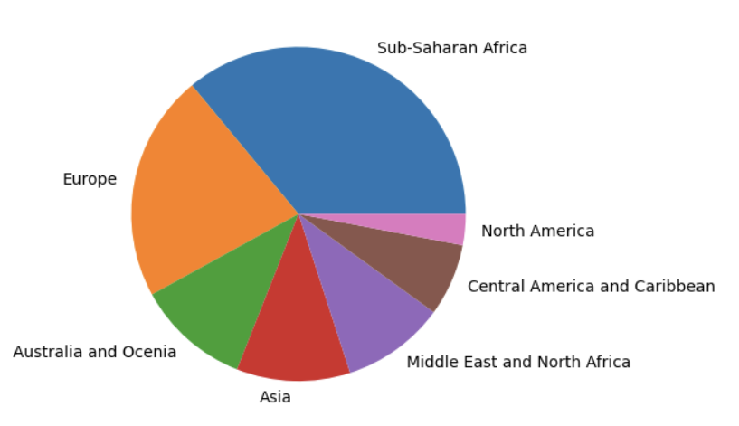
Mock-Up Dashboard
Majority of the Sales are from Sub-Saharan Africa and the Europe

Slide 6
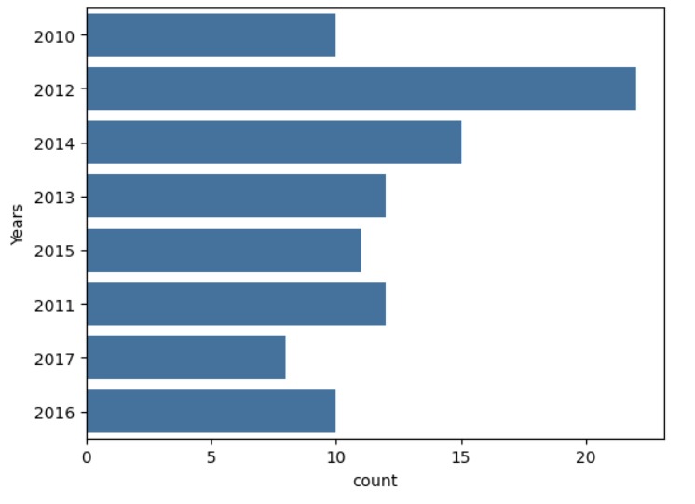
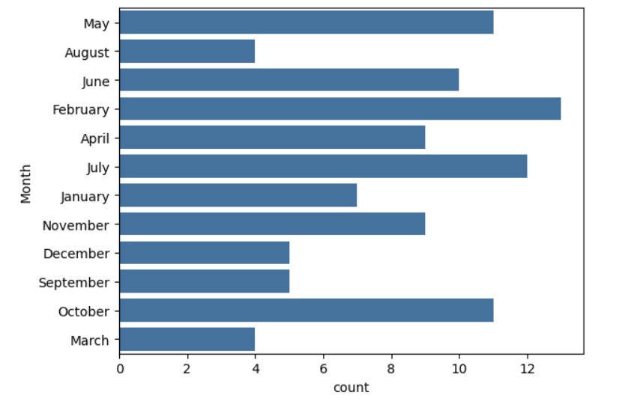
Majority of the sales were occurred in 2012 and Majority of the sales are from the Month of February.

Slide 7
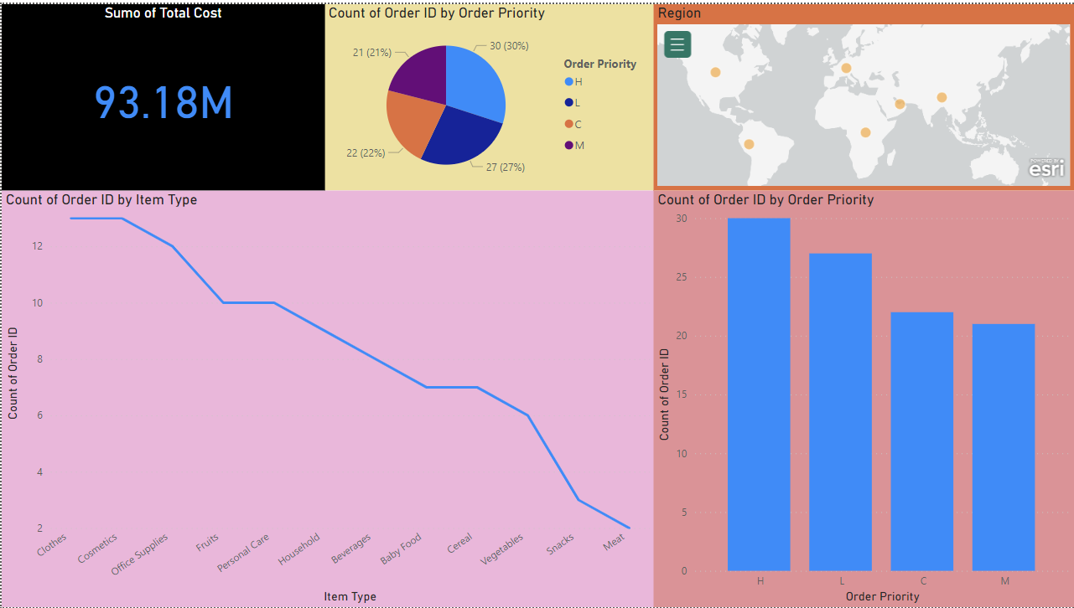
My Design

Slide 8
Thank You!

